Slide 1

Let ‘s COOK
Plan2Plate
From planning to plating, we’re with you on your journey to delicious delights

Slide 2

Plan2Plate
is designed to streamline meal planning and grocery shopping for busy individuals by leveraging schedule integration and intelligent recommendations.

Slide 3
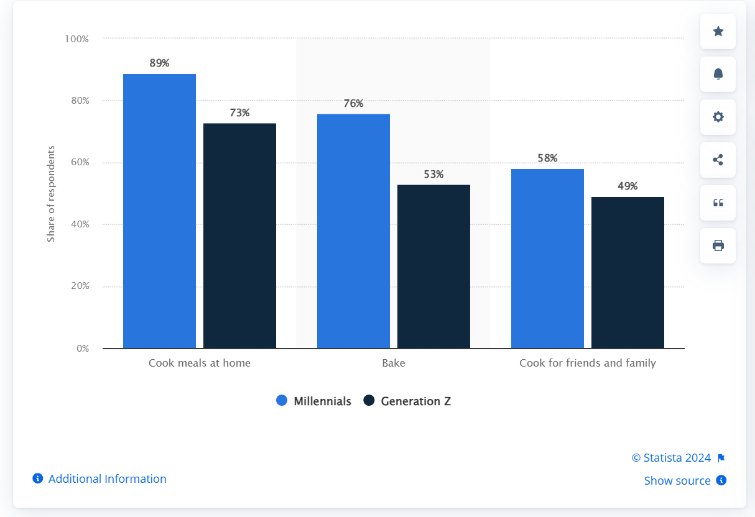
Cooking practices of Millennials and Generation Z in the United States and Canada in 2022
https://www.statista.com/statistics/1309600/north-america-young-adults-cooking-practices/

Slide 4


Meal Planning
By syncing with users' schedules, Plan2Plate identifies available time slots and suggests recipes that fit seamlessly into their daily routines.

Slide 5

Prep Time Calculation
The website calculates preparation time for each recipe, ensuring that users can efficiently plan and prepare meals even with limited time.

Slide 6


Grocery Shopping
Plan2Plate goes beyond recipe suggestions by providing users with information about nearby grocery stores, making it convenient to purchase ingredients.

Slide 7


Save Time
Say goodbye to the hassle of meal planning and grocery shopping by letting Plan2Plate do the work for you.

Slide 8


Healthy Eating & Convenience
Empower users to make healthier food choices by offering well timed recipe recommendations.
Seamlessly integrate meal planning and grocery shopping with your busy schedule, making it easier than ever to maintain a balanced lifestyle.

Slide 9
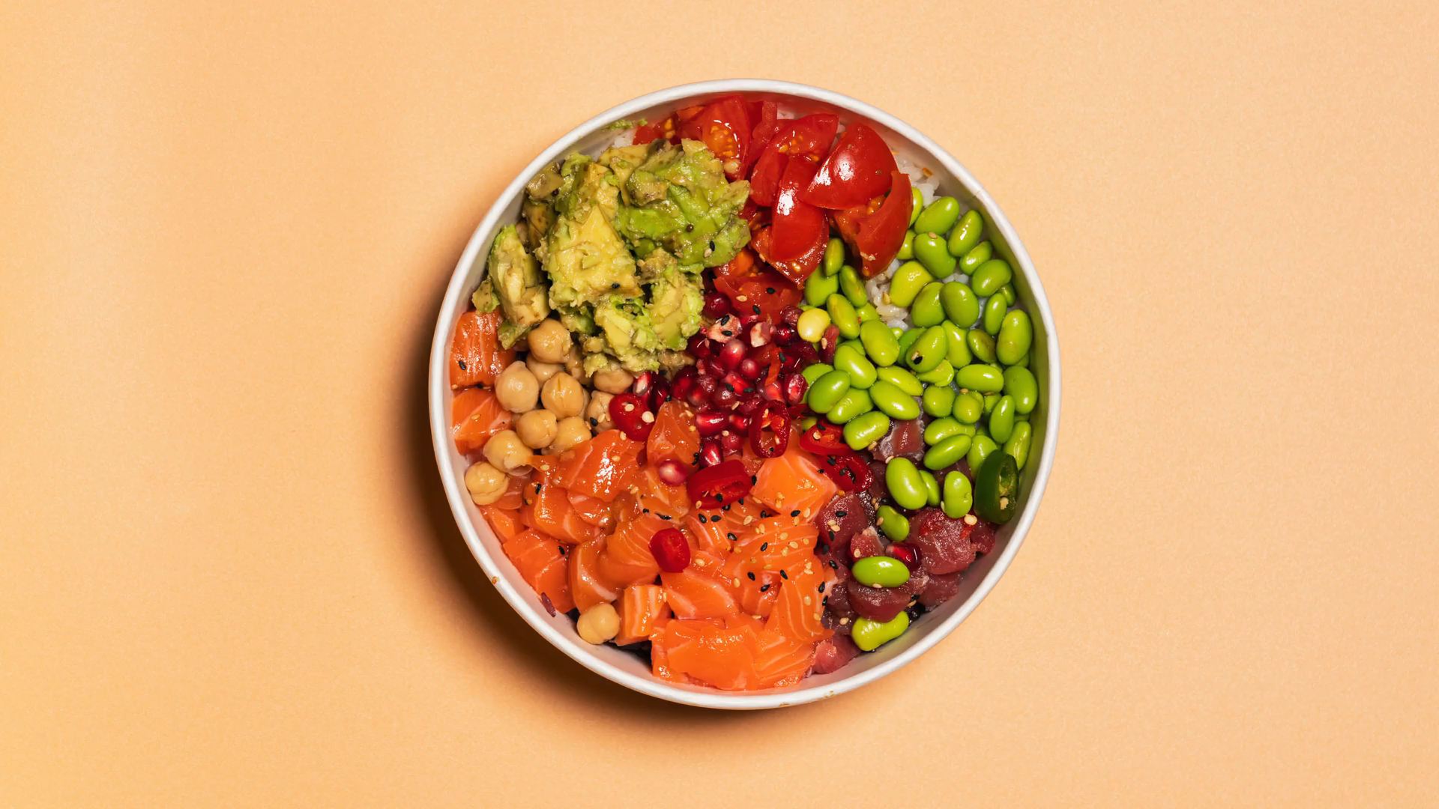

Experience the Difference
Visit Plan2Plate today and discover how effortless meal planning and grocery shopping can be when your schedule works for you!

Slide 10



